Slide 1
Applications of Definite Integrals
BSCS-III-B
Made By: S. Ali Adan Ghayour Mumtaz Tayyab Liaquat Azeem Asghar Ahmed Ameer
M Muhib Khan

Slide 2
Table of contents
01
02
03
Definite Integrals
Fuel Consumption Application
Consumer Surplus Application
Definition and explanation
Code, Explanation and Demo
Code, Explanation and Demo

Slide 3
01
Definite Integrals
What are Definite Integrals???

Slide 4

Understanding Definite Integrals
A Definite Integral represents the area under a curve over a specific interval.
Formula:
Where a and b are the limits of integration, and f(x) is the function being integrated.
They are used to compute quantities like area, total change, and cumulative effects in real-world applications.

Slide 5
Applications of Definite Integrals
Why Are Definite Integrals Important?
Calculate physical quantities like distance, velocity, and fuel consumption.
Measure economic metrics like consumer surplus and producer surplus.
Model systems in engineering, physics, and economics.

Slide 6


Applications Made In The Project
Fuel Consumption
To compute total fuel consumed by a vehicle over time, considering speed variations.
Consumer Surplus
the difference between what consumers are willing to pay and what they actually pay.

Slide 7
02
Fuel Consumption
Application 1:

Slide 8



Fuel Consumption Calculation
Objective:
Analyze and compute the total fuel consumption based on varying speed over time.
Formula Used:
Fuel Consumption Rate:
Speed Variation:
Total Fuel:

Slide 9



Main Code Functions:
Fuel consumption Rate
Speed Over Time
Fuel Rate Over Time
Calculates fuel rate based on speed.
Models speed variation using a sinusoidal function.
Combines speed and fuel rate for integration.

Slide 10
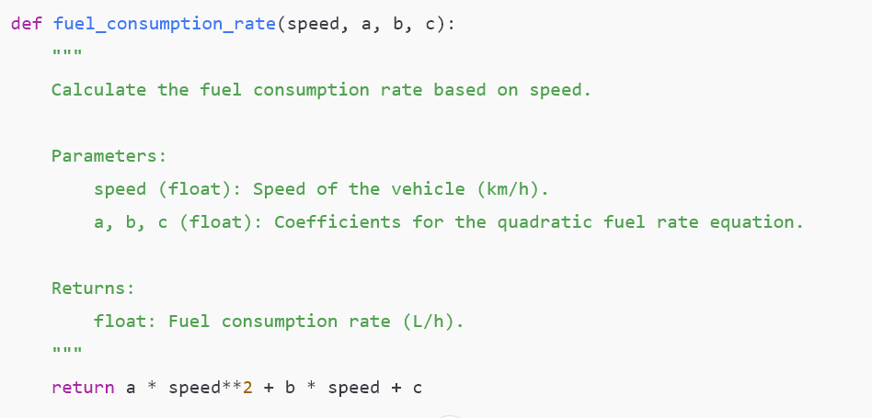
Fuel Consumption Rate Snippet:

Slide 11
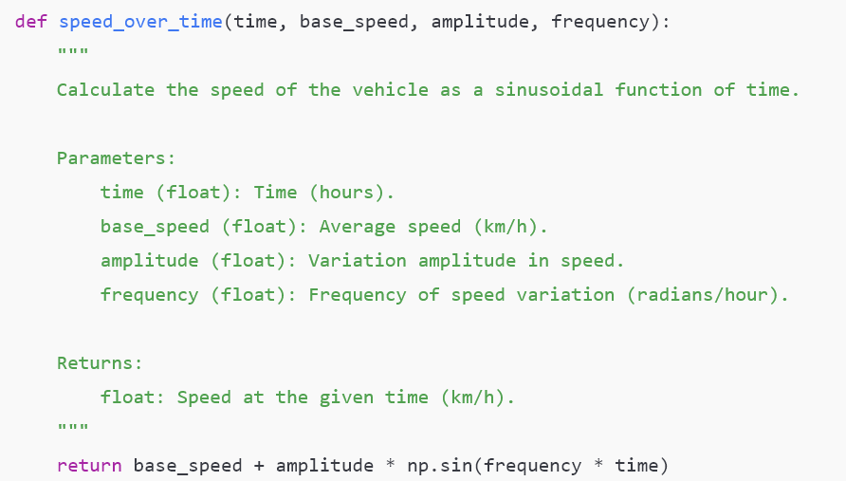
Speed Over Time Snippet:

Slide 12
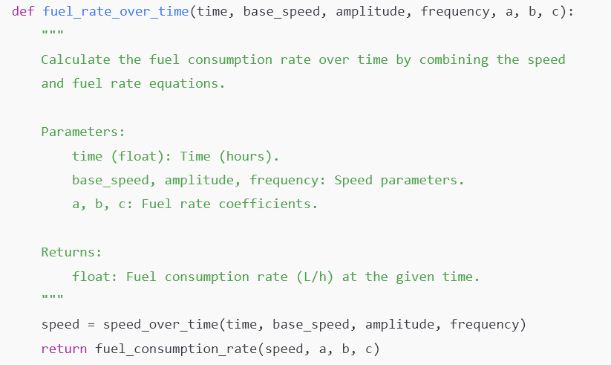
Fuel Rate Over Time

Slide 13
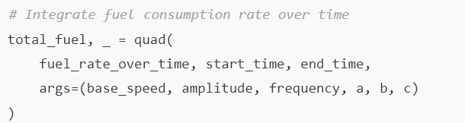
Fuel Consumption Integration:

Slide 14
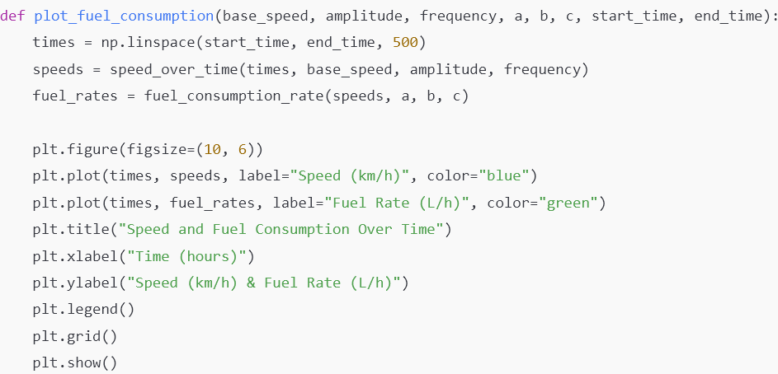
Fuel Consumption Graph:

Slide 15
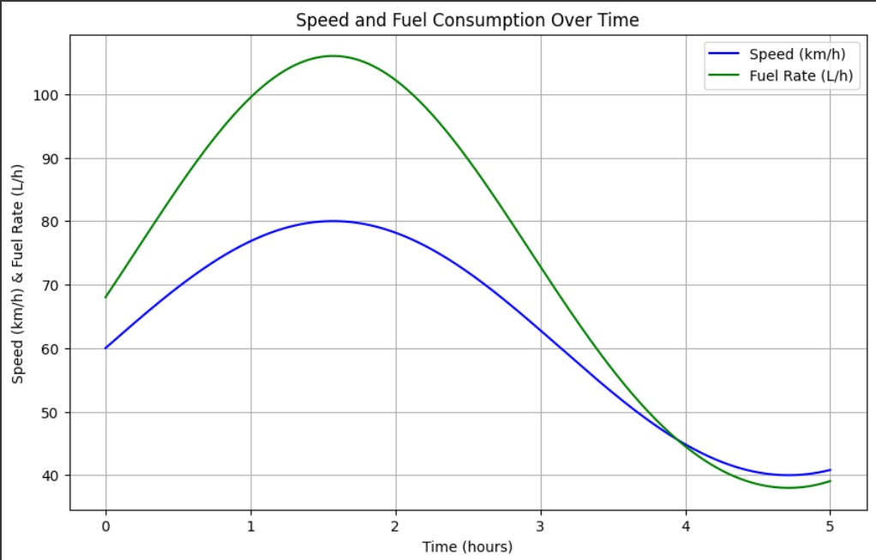
Example Graph:
Example Values:
Start Time: 0 hours
End Time: 5 hours
Base speed: 60 km/h
Speed Variation Amplitude: 20 km/h
Speed Variation Frequency: 1 cycle/hour
Coefficient a for Fuel Rate: 0.01
Coefficient b for Fuel Rate: 0.5
Coefficient c for Fuel Rate: 2

Slide 16
Demo:

Slide 17
03
Consumer Surplus
Application 2:

Slide 18

Consumer Surplus Calculation
Objective:
Calculate consumer surplus: the difference between what consumers are willing to pay and what they actually pay.
Formula Used:
Consumer Surplus:

Slide 19

Main Code Functions:
Demand Function
Shows the relationship between the price of a product and the quantity of it that consumers are willing to buy.

Slide 20
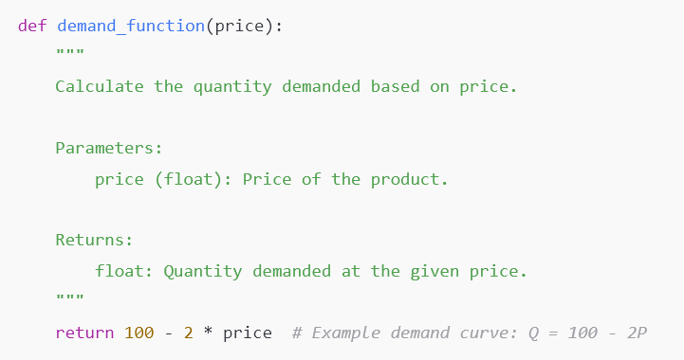
Demand Function Snippet:

Slide 21
Consumer Surplus Integration:

Slide 22
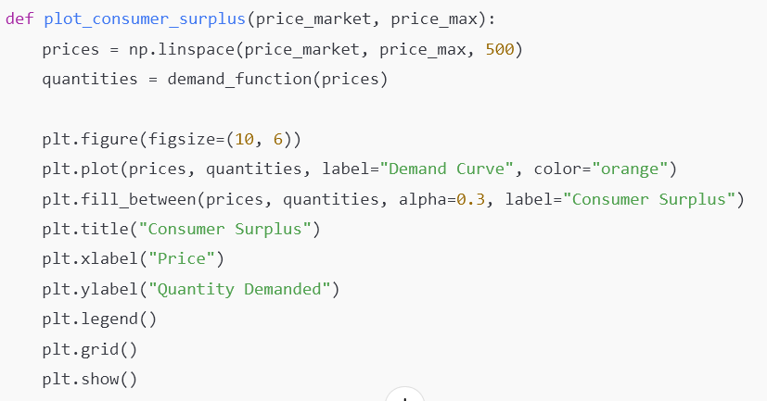
Consumer Surplus Graph:

Slide 23
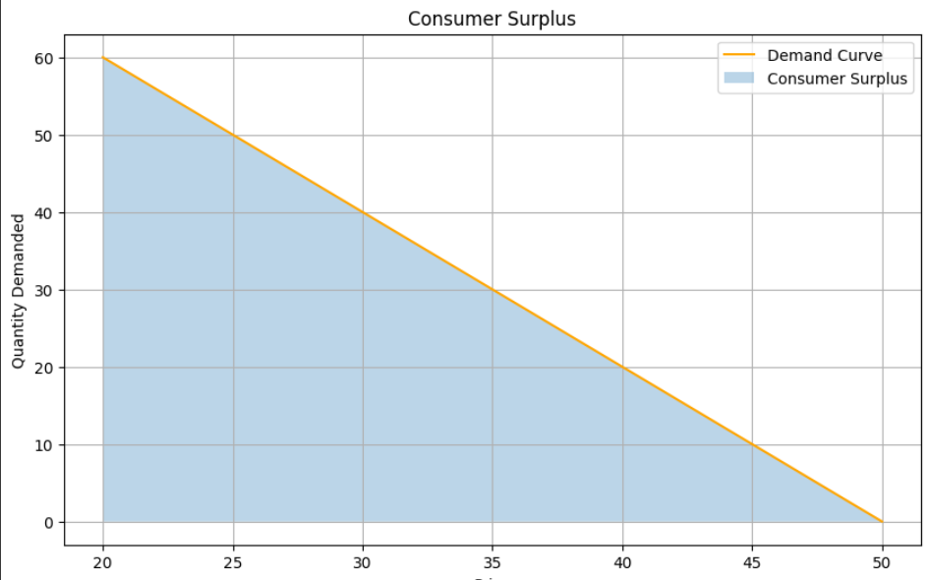
Example Graph:
Example Values:
Market Price: 20$
Max Price Customers Willing to Pay: 50$

Slide 24
Demo:

Slide 25
Conclusion
Summary:
Definite integrals provide powerful tools for solving real-world problems.
Applications in fuel consumption and economic surplus highlight their versatility.
Future Scope:
Expand to more complex real-life scenarios.
Use machine learning to predict and optimize inputs.

Slide 26
References
Libraries Used:
SciPy: A Python library used for advanced mathematical functions, scientific computing, and integration tasks.
Matplotlib: A Python library for creating static, animated, and interactive visualizations like graphs and charts.
NumPy: A Python library for numerical computing, providing support for arrays, matrices, and mathematical operations.

Slide 27
Thanks!

